Slide 1
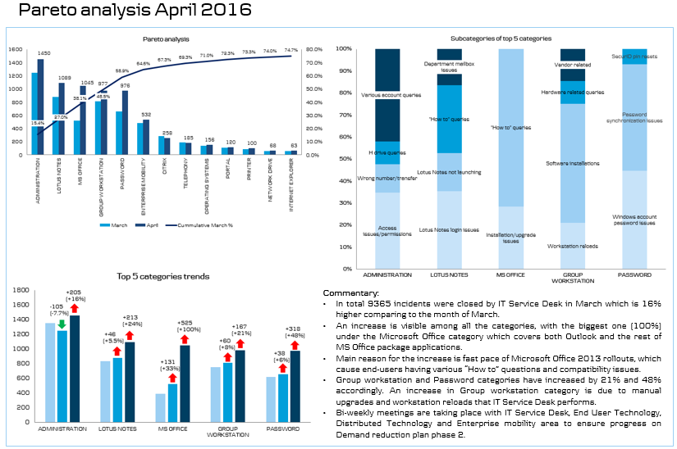
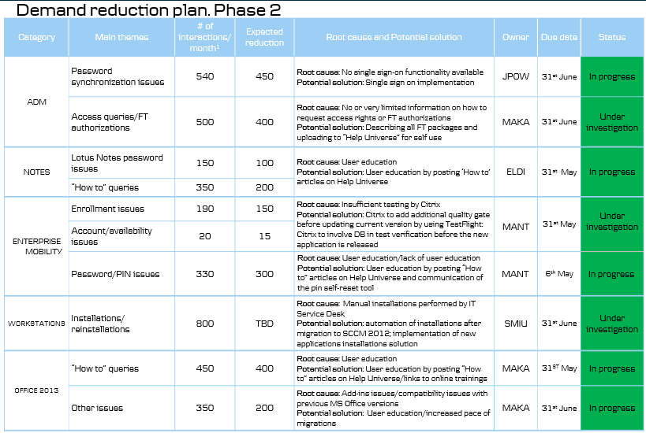
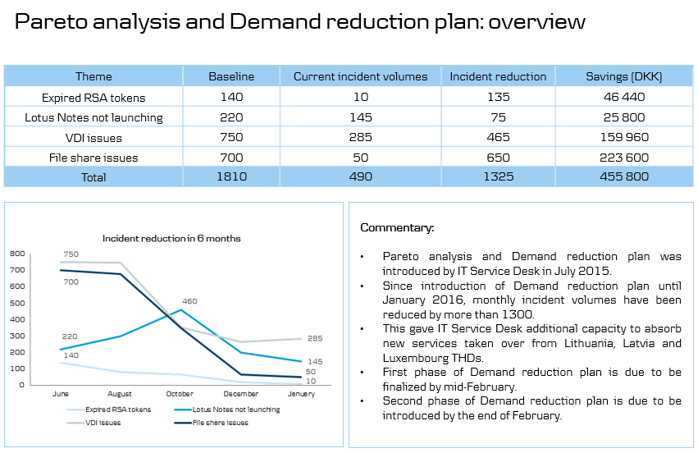
Demand Reduction Approach
Why: Utilizing data and closed loop improvements are key elements to achieve efficient and proactive services. Used fully, Demand Reductions results in lower levels of calls for issues, maximizes business operating time, and thus improve user and customer experiences. A best practice approach to the analysis enables rapid and consistent adoption by service desks.
How: Demand reduction begins by analysing the data from interactions, identifying the causes for top reasons calls occur and then working together with the issue owners to ensure solutions are implemented. Of course, the service call data must be in place and of sufficient quality for analysis.
Service Desk
Perform Pareto analysis to identify top demand areas
Identify main issues and issue owners
Initiate dialogue with issue owners, support with data
Identify root cause, propose solutions
Plan activities, set timelines
Report on progress
Issue owner
Verify issue ownership or point to other owners
Tools
Reduction plan

